Slide 1


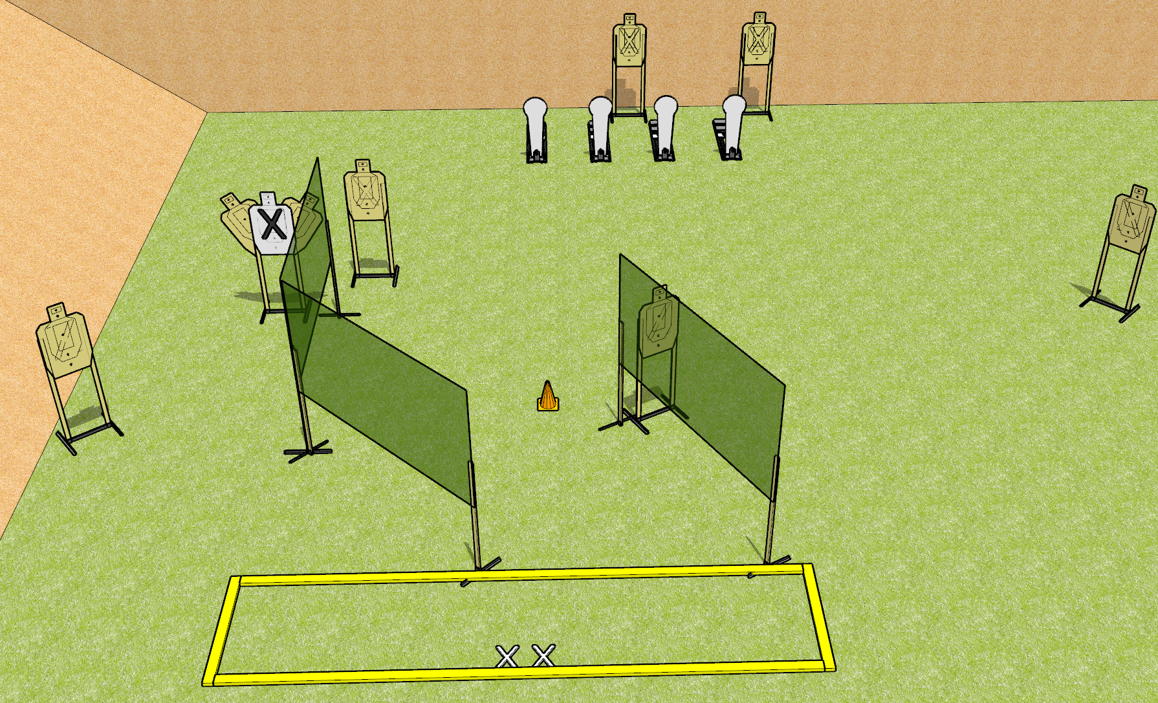
 | Dothan Gun Club – USPSA Match Single Shot Course Designer : Drew Coleman
START POSITION : Standing with both feet on X’s, wrists below belt
GUN READY CONDITION : Pistol unloaded and holstered. PCC unloaded, shouldered, safety on, pointed at orange cone. |  | SCORING: Comstock, 12 rounds TARGETS: 8 paper, 4 Steel SCORED HITS: Best 1 on paper, steel until down START-STOP: Audible, last shot RULES:
STAGE PROCEDURE: Engage targets as they become available from within the fault lines.

